Slide 1


B.Tech CS KCS301 - Data Structure
KIET Group of Institutions, Delhi-NCR Ghaziabad
affiliated to DR. APJ Abdul Kalam Technical University, Lucknow
Lecture – 28 Iteration and Recursion
Scenario Based Questions
By
Harsh Khatter
Assistant Professor
Department of Computer Science

Slide 2
RECAP
Need of Iteration
Working with Iteration
Principles of recursion,
Why Recursion (Time/Space Tradeoff)
Types of Recursion**

Slide 3
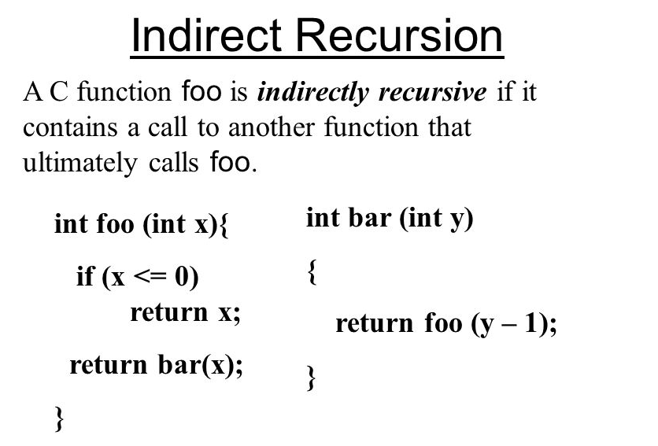
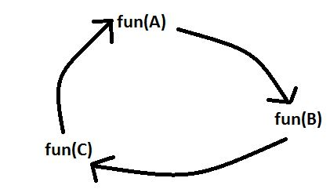
Types of Recursion
Linear/Direct Recursion:
A function calls itself from within itself.
Indirect Recursion:
A function calls itself from more than one function call one another mutually.

Slide 4
Types of Recursion
Tail Recursion:
A recursive function is called the tail-recursive if the function makes recursive calling itself, and that recursive call is the last statement executes by the function.
After that, there is no function or statement is left to call the recursive function.
// An example of tail recursive function
void print(int n)
{
if (n < 0) return;
cout << " " << n;
// The last executed statement is recursive call
print(n-1);
}

Slide 5
Types of Recursion
4. Non Tail/ Head Recursion:
The recursive call will be the first statement in the function.
It means there should be no statement or operation is called before the recursive calls.
The head recursive does not perform any operation at the time of recursive calling.
Instead, all operations are done at the return time.

Slide 6
About Non-Tail Recursion
When a procedure is called, its information is pushed onto a stack, and when the function terminates the information is popped out of the stack.
Thus for the non-tail-recursive functions,
the stack depth (maximum amount of stack space used at any time during compilation) is more.

Slide 7
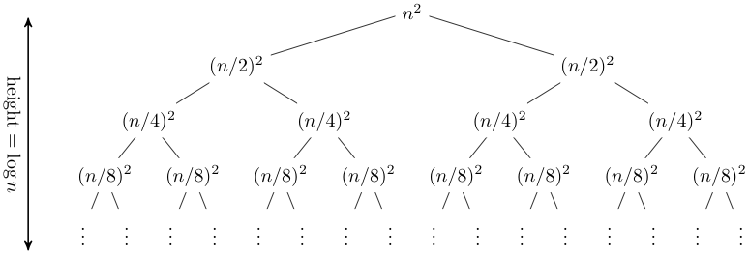
Types of Recursion
5. Tree Recursion:
The recursive call in the function is in parts: Left & Right
rec(n-1), rec(n+1)

Slide 8
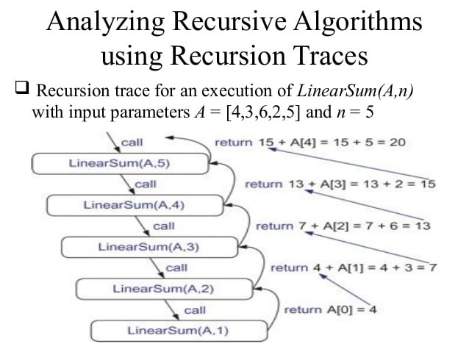

Slide 9
Types of Recursion
5. Tree Recursion:
The recursive call in the function is in parts: Left & Right
rec(n-1), rec(n+1)

Slide 10
Removal of Recursion
Although recursion is easier to be implemented in some cases, we need to learn how to program the same function without recursion.
For some systems, system memory is not big enough, recursion will make it run out of memory.
For the overhead of a recursion, it takes much space to store variables into the system storage.

Slide 11
Removal of Recursion
Here, as we know, the recursion mentioned above can be removed by two ways, Iteration (loop) and Stack.
By Iteration, The rules of Recursion Removal [1] is quoted:
Recursion can be removed by replace the selection structure with a loop.
If some data need to be stored for processing after the end of the recursive step, a data structure is needed in addition to the loop
The data structure vary from a simple string or an array to a stack.

Slide 12
Removal of Recursion
int Fibonnaci(int n) { if (n == 0) return 0; if (n == 1) return 1; if (n > 95) return -1;
// overflow, int n1 = 1, n0 = 0, nth = 0; while(--n > 2)
{ // control the number of loops nth = n1 + n0; n0 = n1; n1 = nth; } return nth; }

Slide 13
Removal of Recursion
Although recursion is easier to be implemented in some cases, we need to learn how to program the same function without recursion.
For some systems, system memory is not big enough, recursion will make it run out of memory.
For the overhead of a recursion, it takes much space to store variables into the system storage.

Slide 14
Scenario Based
Fibonacci Series
Binary Search
Tower of Hanoi

Slide 15
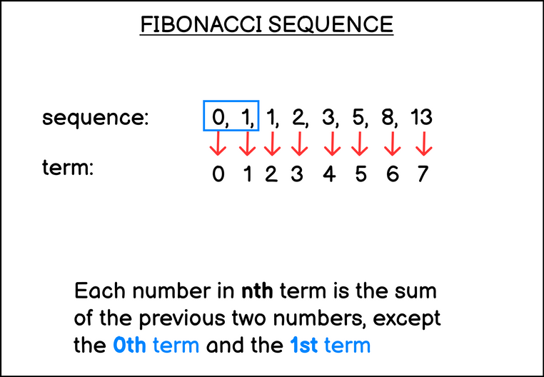
Fn = Fn-1 + Fn-2

Slide 16
Steps for Fibonacci Recursion
There are three steps you need to do in order to write a recursive function, they are:
Creating a regular function with a base case that can be reached with its parameters
Passing arguments into the function that immediately trigger the base case
Passing a different, more complex arguments that trigger the recursive call just once.

Slide 17
Steps for Fibonacci Recursion
There are three steps you need to do in order to write a recursive function, they are:
Creating a regular function with a base case that can be reached with its parameters
Passing arguments into the function that immediately trigger the base case
Passing a different, more complex arguments that trigger the recursive call just once.

Slide 18
Steps for Fibonacci Recursion
There are three steps you need to do in order to write a recursive function, they are:
Creating a regular function with a base case that can be reached with its parameters
Passing arguments into the function that immediately trigger the base case
Passing a different, more complex arguments that trigger the recursive call just once.
For a Fibonacci sequence, the base case is that the
zeroth and first number of the sequence are 0 and 1 respectively.
You can write the base case in two ways:
if(n==0) return 0;
if(n== 1) return 1;

Slide 19
Steps for Fibonacci Recursion
Or you can write if (n < 2) return n because 0 + 1 equals to 1 anyway.
Let’s start writing the function:
function fib(n)
{
if (n < 2)
return n;
}
There are three steps you need to do in order to write a recursive function, they are:
Creating a regular function with a base case that can be reached with its parameters
Passing arguments into the function that immediately trigger the base case
Passing a different, more complex arguments that trigger the recursive call just once.
function fib(n)
{
if (n < 2)
return n;
return fib(n - 1) + fib(n - 2); // Fn-1 + Fn-2
}

Slide 20
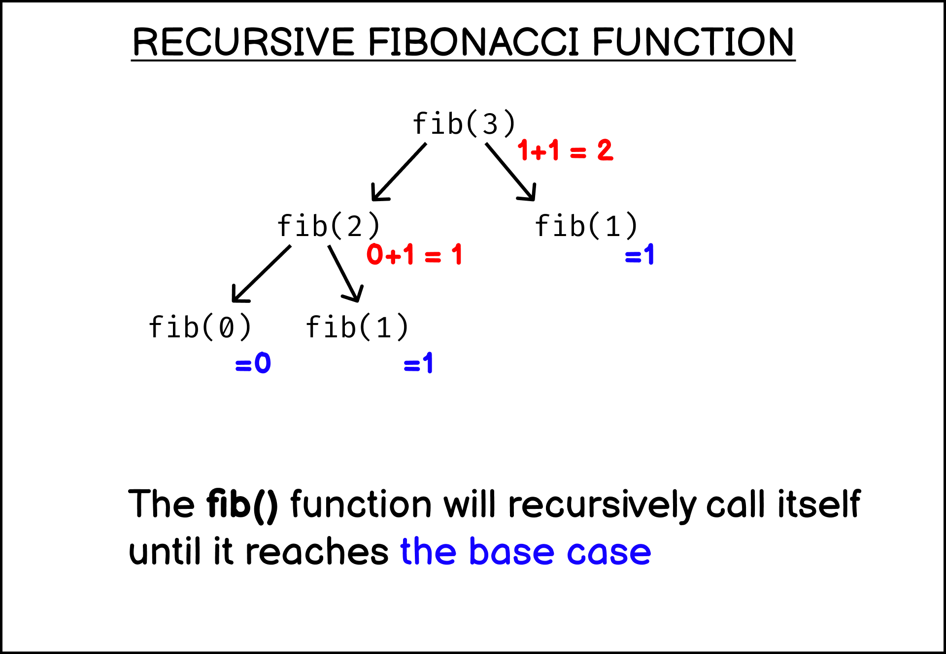
Steps for Fibonacci Recursion

Slide 21
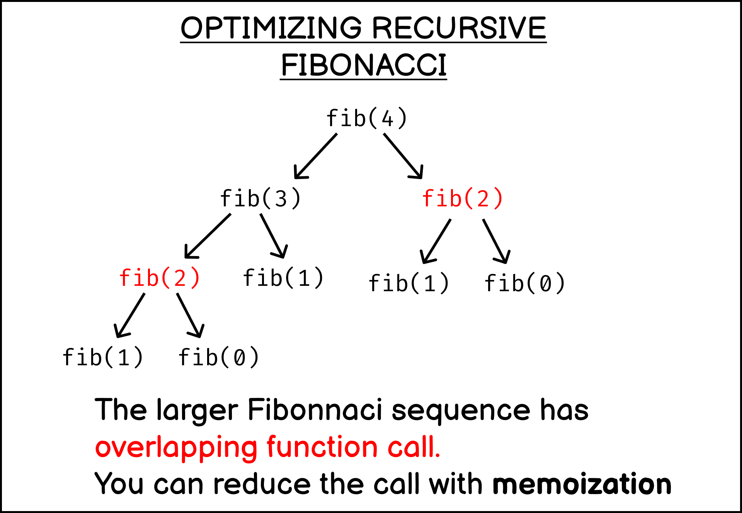
Steps for Fibonacci Recursion
There are three steps you need to do in order to write a recursive function, they are:
Creating a regular function with a base case that can be reached with its parameters
Passing arguments into the function that immediately trigger the base case
Passing a different, more complex arguments that trigger the recursive call just once.

Slide 22
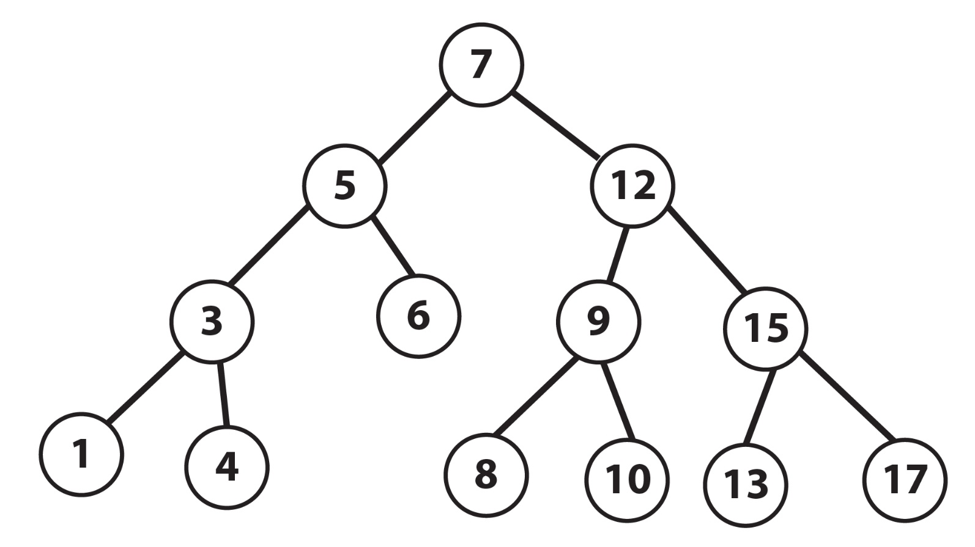
Binary Search

Slide 23
Session Outcome
Student is able to:
Understand the concept of Recursion
Know the steps involved in Recursion
Analyze the iterative and recursive approach
How recursion is using Stack
Understand the types of recursion

